Slide 1

Pakistani Dish Recognizer
AI
Artificial Intelligence
Muhammad Ahsan 1912310 Shayan Ali Mankani 1912322

Slide 2

Pakistani Dish Recognizer
CSC4101 Artificial Intelligence
PURPOSE
WORKING
The idea behind the project is to make people, especially foreigners familiar with the Pakistani dishes. It will be able to recognize the dishes by detecting the images.
Food logging is being considered one of the most data-collecting activity that users do with their smartphones (taking snapshots of their meals, sharing on social media, etc.). There could be ease of use such as taking a picture and getting to know what type of dish it is.
The project heavily relies on a Convolutional Neural Network (CNN) for the tasks of recognizing food images. The model that has been opted is Efficient Net.
The UI of the project is done through flask framework, with the webcam integration of 720p.
The camera will capture the image and identify the dish.

Slide 3
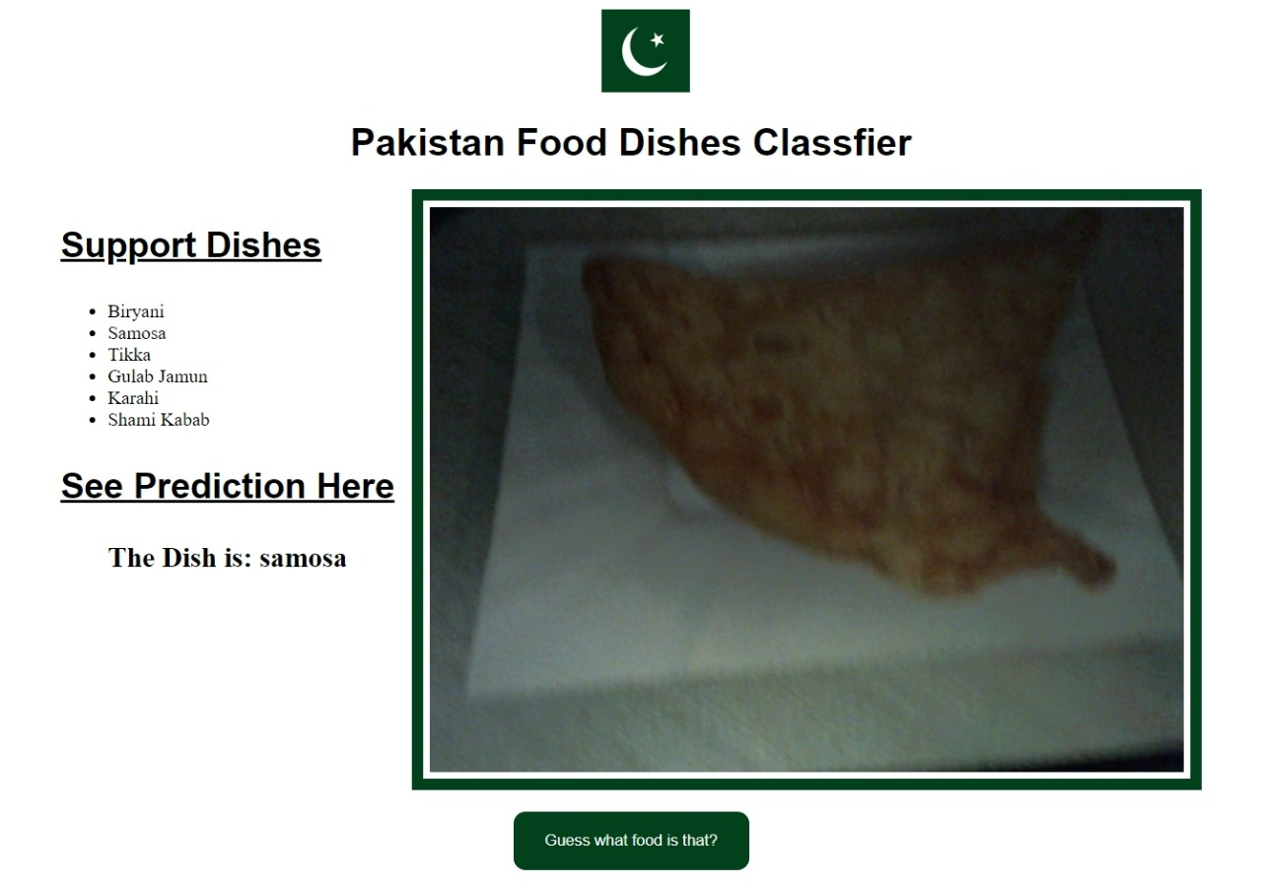
UI

Slide 4
Challenges
The hardest challenge was to achieve the target of collecting the quality data in short time.
With Pakistani dishes, which most of them seems kind of similar and not having enough data in hand, to attain the accuracy was a challenge.
We did managed to get 96% accuracy and 16% loss.

Slide 5
Thank You!

